Slide 1

Programming Languages Third Edition
Chapter 3
Functional Programming

Slide 2
Objectives
Understand the concepts of functional programming
Understand delayed evaluation (closures)
Understand currying
Become familiar with JavaScript
Understand the mathematics of functional programming

Slide 3
Functional Programming Topics
Terms
Math connection
History
Lambda Calculus
Universal model of computation
Church - Turing
Purity / Side Effects
Referential Transparency
Functional Composition
First Class Functions
Higher-order Functions (pg 178)
Loops
Recursion vs Iteration
Tail-end Recursion
Immutable
Currying
Closures
Type Systems
Pattern matching (pg 347)

Slide 4
Useful links
So You Want to be a Functional Programmer?
https://medium.com/@cscalfani/so-you-want-to-be-a-functional-programmer-part-1-1f15e387e536
Closures
http://stackoverflow.com/questions/111102/how-do-javascript-closures-work
Pipeline example
https://maryrosecook.com/blog/post/a-practical-introduction-to-functional-programming

Slide 5
Purity
When Functional Programmers talk of Purity, they are referring to Pure Functions.
Pure Functions are very simple functions. They only operate on their input parameters.
Here’s an example in Javascript of a Pure Function:
var z = 10; function add(x, y) { return x + y; }

Slide 6
Background
Several different styles of programming, including:
Functional programming
Logic programming
Object-oriented programming
Different languages have evolved to support each style of programming
Each type of language rests on a distinct model of computation, which is different from the von Neumann model

Slide 7
Background (cont’d.)
Functional programming:
Provides a uniform view of programs as functions
Treats functions as data
Provides prevention of side effects
Functional programming languages generally have simpler semantics and a simpler model of computation
Useful for rapid prototyping, artificial intelligence, mathematical proof systems, and logic applications

Slide 8
Background (cont’d.)
Until recently, most functional languages suffered from inefficient execution
Most were originally interpreted instead of compiled
Today, functional languages are very attractive for general programming
They lend themselves very well to parallel execution
May be more efficient than imperative languages on multicore hardware architectures
Have mature application libraries

Slide 9
Background (cont’d.)
Despite these advantages, functional languages have not become mainstream languages for several reasons:
Programmers learn imperative or object-oriented languages first
OO languages provide a strong organizing principle for structuring code that mirrors the everyday experience of real objects
Functional methods such as recursion, functional abstraction, and higher-order functions have become part of many programming languages

Slide 10
Programs as Functions
A program is a description of specific computation
If we ignore the “how” and focus on the result, or the “what” of the computation, the program becomes a virtual black box that transforms input into output
A program is thus essentially equivalent to a mathematical function
Function: a rule that associates to each x from set of X of values a unique y from a set Y of values

Slide 11
Programs as Functions (cont’d.)
In mathematical terminology, the function can be written as y=f(x) or f:X→Y
Domain of f: the set X
Range of f: the set Y
Independent variable: the x in f(x), representing any value from the set X
Dependent variable: the y from the set Y, defined by y=f(x)
Partial function: occurs when f is not defined for all x in X

Slide 12
Programs as Functions (cont’d.)
Total function: a function that is defined for all x in the set X
Programs, procedures, and functions can all be represented by the mathematical concept of a function
At the program level, x represents the input, and y represents the output
At the procedure or function level, x represents the parameters, and y represents the returned values

Slide 13
Programs as Functions (cont’d.)
Functional definition: describes how a value is to be computed using formal parameters
Functional application: a call to a defined function using actual parameters, or the values that the formal parameters assume for a particular computation
In math, there is not always a clear distinction between a parameter and a variable
The term independent variable is often used for parameters

Slide 14
Programs as Functions (cont’d.)
A major difference between imperative programming and functional programming is the concept of a variable
In math, variables always stand for actual values
In imperative programming languages, variables refer to memory locations that store values
Assignment statements allow memory locations to be reset with new values
In math, there are no concepts of memory location and assignment

Slide 15
Programs as Functions (cont’d.)
Functional programming takes a mathematical approach to the concept of a variable
Variables are bound to values, not memory locations
A variable’s value cannot change, which eliminates assignment as an available operation
Most functional programming languages retain some notion of assignment
It is possible to create a pure functional program that takes a strictly mathematical approach to variables

Slide 16
Programs as Functions (cont’d.)
Lack of assignment makes loops impossible
A loop requires a control variable whose value changes as the loop executes
Recursion is used instead of loops
There is no notion of the internal state of a function
Its value depends only on the values of its arguments (and possibly nonlocal variables)
A function’s value cannot depend on the order of evaluation of its arguments
An advantage for concurrent applications

Slide 17
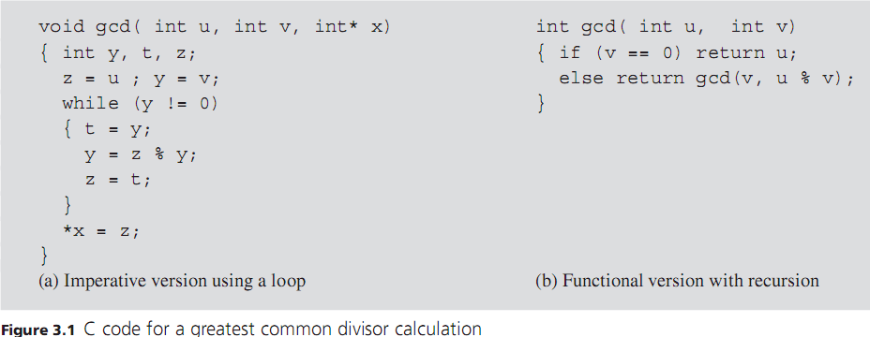
Programs as Functions (cont’d.)

Slide 18
Programs as Functions (cont’d.)
Referential transparency: the property whereby a function’s value depends only on the values of its variables (and nonlocal variables)
Examples:
gcd function is referentially transparent
rand function is not because it depends on the state of the machine and previous calls to itself
A referentially transparent function with no parameters must always return the same value
Thus it is no different than a constant

Slide 19
Programs as Functions (cont’d.)
Referential transparency and the lack of assignment make the semantics straightforward
Value semantics: semantics in which names are associated only to values, not memory locations
Lack of local state in functional programming makes it opposite of OO programming, wherein computation proceeds by changing the local state of objects
In functional programming, functions must be general language objects, viewed as values themselves

Slide 20
Programs as Functions (cont’d.)
In functional programming, functions are first-class data values
Functions can be computed by other functions
Functions can be parameters to other functions
Composition: essential operation on functions
A function takes two functions as parameters and produces another function as its returned value
In math, the composition operator o is defined:
If f:X→Y and g:Y→Z, then g o f:X→Z is given by
(g o f)(x) = g(f(x))

Slide 21
Programs as Functions (cont’d.)
Qualities of functional program languages and functional programs:
All procedures are functions that distinguish incoming values (parameters) from outgoing values (results)
In pure functional programming, there are no assignments
In pure functional programming, there are no loops
Value of a function depends only on its parameters, not on order of evaluation or execution path
Functions are first-class data values

Slide 22
Scheme: A Dialect of Lisp
Lisp (LISt Processing): first language that contained many of the features of modern functional languages
Based on the lambda calculus
Features included:
Uniform representation of programs and data using a single general structure: the list
Definition of the language using an interpreter written in the same language (metacircular interpreter)
Automatic memory management by the runtime system

Slide 23
Scheme: A Dialect of Lisp (cont’d.)
No single standard evolved for Lisp, and there are many variations
Two dialects that use static scoping and a more uniform treatment of functions have become standard:
Common Lisp
Scheme

Slide 24
The Elements of Scheme
All programs and data in Scheme are considered expressions
Two types of expressions:
Atoms: like literal constants and identifiers of an imperative language
Parenthesized expression: a sequence of zero or more expressions separated by spaces and surrounded by parentheses
Syntax is expressed in extended Backus-Naur form notation

Slide 25
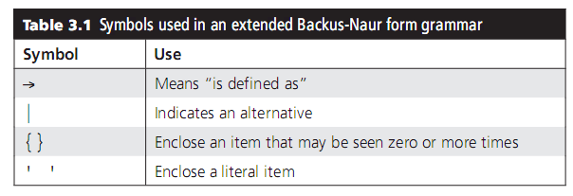
The Elements of Scheme (cont’d.)

Slide 26
The Elements of Scheme (cont’d.)
Syntax of Scheme:
expression → atom | ‘(‘ {expression} ’)’
atom → number | string | symbol | character | boolean
When parenthesized expressions are viewed as data, they are called lists
Evaluation rule: the meaning of a Scheme expression
An environment in Scheme is a symbol table that associates identifiers with values

Slide 27
The Elements of Scheme (cont’d.)
Standard evaluation rule for Scheme expressions:
Atomic literals evaluate to themselves
Symbols other than keywords are treated as identifiers or variables that are looked up in the current environment and replaced by values found there
A parenthesized expression or list is evaluated in one of two ways:
If the first item is a keyword, a special rule is applied to evaluate the rest of the expression
An expression starting with a keyword is called a special form

Slide 28
The Elements of Scheme (cont’d.)
Otherwise, the parenthesized expression is a function application
Each expression within the parentheses is evaluated recursively
The first expression must evaluate to a function, which is then applied to remaining values (its arguments)
The Scheme evaluation rule implies that all expressions must be written in prefix form
Example: (+ 2 3)
+ is a function, and it is applied to the values 2 and 3, to return the value 5

Slide 29
The Elements of Scheme (cont’d.)
Evaluation rule also implies that the value of a function (as an object) is clearly distinguished from a call to the function
Function is represented by the first expression in an application
Function call is surrounded by parentheses
Evaluation rule represents applicative order evaluation:
All subexpressions are evaluated first
A corresponding expression tree is evaluated from leaves to root

Slide 30
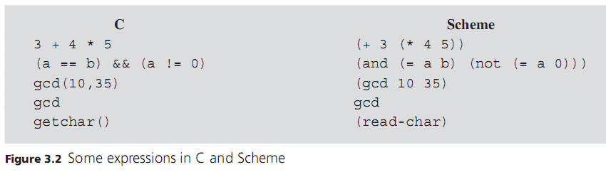
The Elements of Scheme (cont’d.)

Slide 31
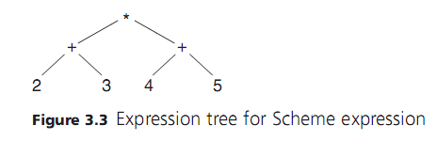
The Elements of Scheme (cont’d.)
Example: (* (+ 2 3) (+ 4 5 ))
Two additions are evaluated first, then the multiplication

Slide 32
The Elements of Scheme (cont’d.)
A problem arises when data are represented directly in a program, such as a list of numbers
Example: (2.1 2.2 3.1)
Scheme will try to evaluate it as a function call
Must prevent this and consider it to be a list literal, using a special form with the keyword quote
Example: (quote (2.1 2.2 3.1))
Rule for evaluating a quote special form is to simply return the expression following quote without evaluating it

Slide 33
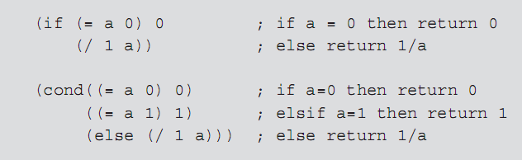
The Elements of Scheme (cont’d.)
Loops are provided by recursive call
Selection is provided by special forms:
if form: like an if-else construct
cond form: like an if-elseif construct; cond stands for conditional expression

Slide 34
The Elements of Scheme (cont’d.)
Neither the if nor the cond special form obey the standard evaluation rule
If they did, all arguments would be evaluated each time, rendering them useless as control mechanisms
Arguments to special forms are delayed until the appropriate moment
Scheme function applications use pass by value, while special forms in Scheme and Lisp use delayed evaluation

Slide 35
The Elements of Scheme (cont’d.)
Special form let: binds a variable to a value within an expression
Example: (let ((a 2) (b 3)) (+ 1 b))
First expression in a let is a binding list
let provides a local environment and scope for a set of variable names
Similar to temporary variable declarations in block-structured languages
Values of the variables can be accessed only within the let form, not outside it

Slide 36
The Elements of Scheme (cont’d.)
lambda special form: creates a function with the specified formal parameters and a body of code to be evaluated when the function is applied
Example:
(lambda (radius) (* 3.14 (* radius radius)))
Can apply the function to an argument by wrapping it and the argument in another set of parentheses:
((lambda (radius) (* 3.14 (* radius radius))) 10)

Slide 37
The Elements of Scheme (cont’d.)
Can bind a name to a lambda within a let:
(let ((circlearea (lambda (radius) (* 3.14 (* radius radius))))) (circlearea 10))
let cannot be used to define recursive functions since let bindings cannot refer to themselves or each other
letrec special form: works like a let but allows arbitrary recursive references within the binding list
(letrec ((factorial (lambda (n) (if (= n 0) 1 (* n (factorial (- n 1))))))) (factorial 10)

Slide 38
The Elements of Scheme (cont’d.)
let and letrec forms create variables visible within the scope and lifetime of the let or letrec
define special form: creates a global binding of a variable visible in the top-level environment

Slide 39
Dynamic Type Checking
Scheme’s semantics include dynamic or latent type checking
Only values, not variables, have data types
Types of values are not checked until necessary at runtime
Automatic type checking happens right before a primitive function, such as +
Arguments to programmer-defined functions are not automatically checked
If wrong type, Scheme halts with an error message

Slide 40
Dynamic Type Checking (cont’d.)
Can use built-in type recognition functions such as number? and procedure? to check a value’s type
This slows down programmer productivity and the code’s execution speed

Slide 41
Tail and Non-Tail Recursion
Because of runtime overhead for procedure calls, loops are always preferable to recursion in imperative languages
Tail recursive: when the recursive steps are the last steps in any function
Scheme compiler translates this to code that executes as a loop with no additional overhead for function calls other than the top-level call
Eliminates the performance hit of recursion

Slide 42
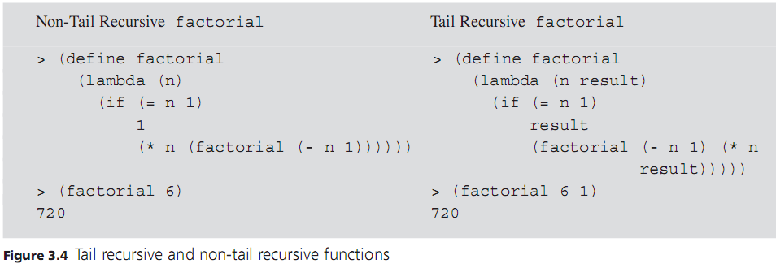
Tail and Non-Tail Recursion (cont’d.)

Slide 43
Tail and Non-Tail Recursion (cont’d.)
Non-tail recursive function example in Figure 3.4:
After each recursive call, the value returned by the call must be multiplied by n (the argument to the previous call)
Requires a runtime stack to track the value of this argument for each call as the recursion unwinds
Entails a linear growth of memory and a substantial performance hit

Slide 44
Tail and Non-Tail Recursion (cont’d.)
Tail recursive function example in Figure 3.4:
All the work of computing values is done when the arguments are evaluated before each recursive call
Argument result is used to accumulate intermediate products on the way down through the recursive calls
No work remains to be done after each recursive call, so no runtime stack is necessary to remember arguments of previous calls

Slide 45
Data Structures in Scheme
Basic data structure in Scheme is the list
Can represent a sequence, a record, or any other structure
Scheme also supports structured types for vectors (one-dimensional arrays) and strings
List functions:
car: accesses the head of the list
cdr: returns the tail of the list (minus the head)
cons: adds a new head to an existing list

Slide 46
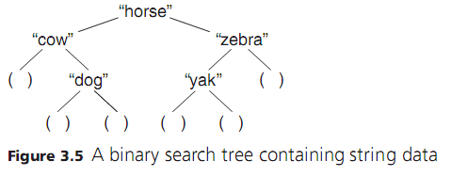
Data Structures in Scheme (cont’d.)
Example: a list representation of a binary search tree
("horse" ("cow" () ("dog" () ()))
("zebra" ("yak" () ()) () ))
A tree node is a list of three items (name left right)

Slide 47
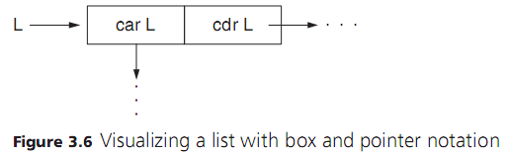
Data Structures in Scheme (cont’d.)
List can be visualized as a pair of values: the car and the cdr
List L is a pointer to a box of two pointers, one to its car and the other to its cdr

Slide 48
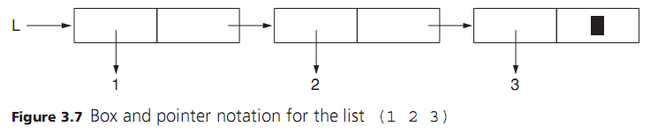
Data Structures in Scheme (cont’d.)
Box and pointer notation for a simple list (1 2 3)
Black rectangle in the end box stands for the empty list ( )

Slide 49
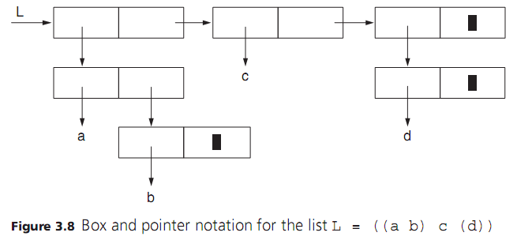
Data Structures in Scheme (cont’d.)

Slide 50
Data Structures in Scheme (cont’d.)
All the basic list manipulation operations can be written as functions using the primitives car, cdr, cons, and null?
null? returns true if the list is empty or false otherwise

Slide 51
Programming Techniques in Scheme
Scheme relies on recursion to perform loops and other repetitive operations
To apply repeated operations to a list, “cdr down and cons up”: apply the operation recursively to the tail of a list and then use the cons operator to construct a new list with the current result
Example:
(define square-list (lambda (L)
(if (null? L) '()
(cons (* (car L) (car L)) (square-list
(cdr L)))))

Slide 52
Higher-Order Functions
Higher-order functions: functions that take other functions as parameters and functions that return functions as values
Example: function with a function parameter that returns a function value
(define make-double (lambda (f)
(lambda (x) (f x x)))
Can now create functions using this:
(define square (make-double *))
(define double (make-double +))

Slide 53
Higher-Order Functions (cont’d.)
Runtime environment of functional languages is more complicated than the stack-based environment of a standard block-structured imperative language
Garbage collection: automatic memory management technique to return memory used by functions

Slide 54
Static (Lexical) Scoping
Early dialects of Lisp were dynamically scoped
Modern dialects, including Scheme and Common Lisp, are statically scoped
Static scope (or lexical scope): the area of a program in which a variable declaration is visible
For static scoping, the meaning or value of a variable can be determined by reading the source code
For dynamic scoping, the meaning depends on the runtime context

Slide 55
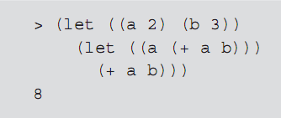
Static (Lexical) Scoping (cont’d.)
Declaration of variables can be nested in block-structured languages
Scope of a variable extends to the end of the block in which it is declared, including any nested blocks (unless it is redeclared within a nesting block)

Slide 56
Static (Lexical) Scoping (cont’d.)
Free variable: a variable referenced within a function that is not also a formal parameter to that function and is not bound within a nested function
Bound variable: a variable within a function that is also a formal parameter to that function
Lexical scoping fixes the meaning of free variables in one place in the code, making a program easier to read and verify than dynamic scoping

Slide 57
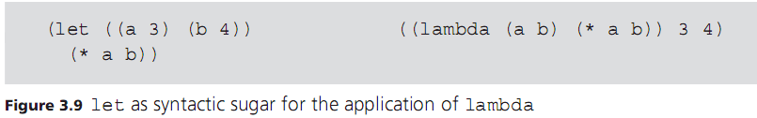
Symbolic Information Processing and Metalinguistic Power
Metalinguistic power: the capacity to build, manipulate, and transform lists of symbols that are then evaluated as programs
Example: let form is actually syntactic sugar for the application of a lambda form to its arguments

Slide 58
ML: Functional Programming with Static Typing
ML (or MetaLanguage): a functional programming language quite different from the dialects of Lisp
Has more Algol-like syntax, which avoids the use of many parentheses
Is statically typed, allows for type-checking
Advantages:
Makes the language more secure since more errors are found prior to execution
Improves efficiency by making type-checking at runtime unnecessary

Slide 59
ML: Functional Programming with Static Typing (cont’d.)
ML was first developed in the late 1970s for proving the correctness of programs
Part of the Edinburgh Logic for Computable Functions (LCF) system
Was later combined with the HOPE language and named Standard ML, or SML
Current standard reflects another revision in 1997, called SML97, or ML97

Slide 60

The Elements of ML
In ML, the basic program is a function declaration
fun: reserved word that introduces a function declaration
Parentheses are almost completely unnecessary since the meaning of items can be determined based solely on their position

Slide 61


The Elements of ML (cont’d.)
A declared function can be called by its name:
ML responds with the returned value and its type
it is the name of the current expression under evaluation
Values can be defined using the val keyword

Slide 62

The Elements of ML (cont’d.)
Arithmetic operators are written as infix operators
Different from the prefix notation of Lisp
Operator precedence and associativity are an issue
ML adheres to the standard math conventions for arithmetic operators
Can turn infix operators into prefix operators using the op keyword:

Slide 63
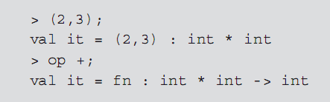
The Elements of ML (cont’d.)
Note that binary arithmetic operators take pairs of integers as their argument
Pairs are elements of the Cartesian product type, or tuple type int * int

Slide 64


The Elements of ML (cont’d.)
In ML, programs are not themselves lists, as they are in Lisp
A list in ML is indicated by square brackets, with elements separated by commas
A list’s elements must all have the same type
To mix data types, must use a tuple:

Slide 65


The Elements of ML (cont’d.)
The operator :: corresponds to cons in Scheme, for constructing a list out of an element (the head) and a previously constructed list (the tail)
Every list is constructed by a series of applications of the :: operator, wherein [] is the empty list
Type variable: denoted by ‘a

Slide 66
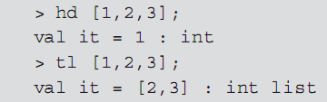
The Elements of ML (cont’d.)
ML operators hd (for head) and tl (for tail) correspond to Scheme’s car and cdr operators
ML’s pattern-matching ability makes these functions unnecessary
Can use h::t to identify the head and tail of a list

Slide 67
The Elements of ML (cont’d.)
Pattern matching can eliminate most uses of if expressions
Example: recursive factorial function using pattern matching:
Patterns can also contain wildcards, written as the underscore character

Slide 68


The Elements of ML (cont’d.)
Because of its strong typing, you must manually convert between data types using a conversion function
ML does not allow overloading of functions

Slide 69

The Elements of ML (cont’d.)
rev function: built-in function that reverses a list
ML makes a strong distinction between types that can be compared for equality and types that cannot
Real numbers cannot be compared for equality
When a polymorphic function definition involves an equality comparison, the type variables can only range over the equality types, written with two quotes

Slide 70
The Elements of ML (cont’d.)
Structure: ML’s version of the library package
Includes several standard predefined resources useful for input and output
Examples: TextIO structure and inputLine and output functions
unit type in ML is similar to the void type of C
Has one value () that represents “no actual value”
Can convert between strings and numbers with toString and fromString functions

Slide 71
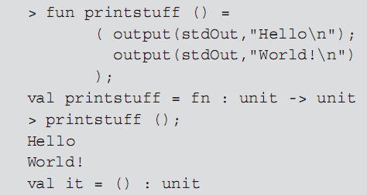
The Elements of ML (cont’d.)
Expression sequence: a semicolon-separated sequence of expressions surrounded by parentheses, whose value is the value of the last expression listed

Slide 72
Data Structures in ML
ML has a rich set of data types, including enumerated types, records, tuples, and lists
type keyword: gives a synonym to an existing data type
datatype keyword produces a user-defined data type
Value constructors (or data constructors): names used in the construction of data types that can be used as patterns
Vertical bar is used to indicate alternative values

Slide 73
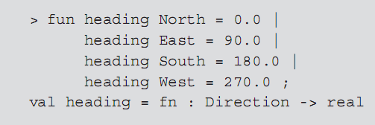
Data Structures in ML (cont’d.)
Example of a value constructor:
Binary search tree can be declared with datatype:

Slide 74

Higher-Order Functions and Currying in ML
fn keyword: denotes a function expression and is followed by =>
Can be used to build anonymous functions and function return values
fun definition is just syntactic sugar for the use of an fn expression
Example:
is equivalent to:

Slide 75
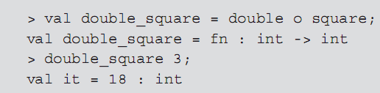
Higher-Order Functions and Currying in ML (cont’d.)
rec keyword: used to declare a recursive function when using fn
Similar to Scheme letrec
Function composition can be done with the letter o

Slide 76
Higher-Order Functions and Currying in ML (cont’d.)
Currying: a process in which a function of multiple parameters is viewed as a higher-order function of a single parameter that returns a function of the remaining parameters
A function to which this process is applied is said to be curried
Can use a tuple to get an “uncurried” version of a function or two separate parameters to get a curried version

Slide 77
Higher-Order Functions and Currying in ML (cont’d.)
A language is said to be fully curried if function definitions are automatically treated as curried and all multiparameter built-in functions are curried
ML is not fully curried since all built-in binary operators are defined as taking tuples

Slide 78
Delayed Evaluation
In a language with an applicative order evaluation rule, all parameters to user-defined functions are evaluated at the time of a call
Examples that do not use applicative order evaluation:
Boolean special forms and and or
if special form
Short-circuit evaluation of Boolean expressions allows a result without evaluating the second parameter

Slide 79
Delayed Evaluation (cont’d.)
Delayed evaluation is necessary for if special form
Example: (if a b c)
Evaluation of b and c must be delayed until the result of a is known; then either b or c is evaluated, but not both
Must distinguish between forms that use standard evaluation (function applications) and those that do not (special forms)
Using applicative order evaluation for functions makes semantics and implementation easier

Slide 80
Delayed Evaluation (cont’d.)
Nonstrict: a property of a function in which delayed evaluation leads to a well-defined result, even though subexpressions or parameters may be undefined
Languages with the property that functions are strict are easier to implement, although nonstrictness can be a desirable property
Algol60 included delayed execution in its pass by name parameter passing convention
A parameter is evaluated only when it is actually used in the code of a called procedure

Slide 81
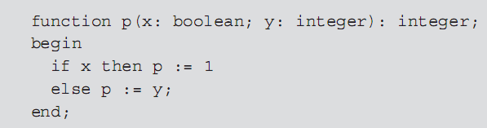
Delayed Evaluation (cont’d.)
Example: Algol60 delayed execution
When called as p(true, 1 div 0), it returns 1 since y is never reached in the code of p
The undefined expression 1 div 0 is never computed

Slide 82
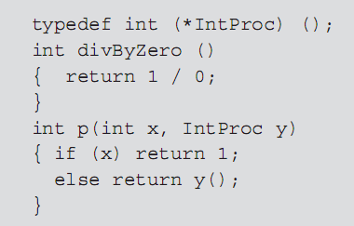
Delayed Evaluation (cont’d.)
In a language with function values, it is possible to delay evaluation of a parameter by enclosing it in a function “shell” (a function with no parameters)
Example: C pass by name equivalent

Slide 83
Delayed Evaluation (cont’d.)
Such “shell” procedures are sometimes referred to as pass by name thunks, or just thunks
In Scheme and ML, the lambda and fn function value constructors can be used to surround parameters with function shells
Example:
which can be called as follows:

Slide 84

Delayed Evaluation (cont’d.)
delay special form: delays evaluation of its arguments and returns an object like a lambda “shell” or promise to evaluate its arguments
force special form: causes its parameter, a delayed object, to be evaluated
Previous function can now be written as:
and called as:

Slide 85
Delayed Evaluation (cont’d.)
Delayed evaluation can introduce inefficiency when the same delayed expression is repeatedly evaluated
Scheme uses a memoization process to store the value of the delayed object the first time it is forced and then return this value for each subsequent call to force
This is sometimes referred to as pass by need

Slide 86
Delayed Evaluation (cont’d.)
Lazy evaluation: only evaluate an expression once it is actually needed
This can be achieved in a functional language without explicit calls to delay and force
Required runtime rules for lazy evaluation:
All arguments to user-defined functions are delayed
All bindings of local names in let and letrec expressions are delayed
All arguments to constructor functions are delayed

Slide 87
Delayed Evaluation (cont’d.)
Required runtime rules for lazy evaluation (cont’d.):
All arguments to other predefined functions are forced
All function-valued arguments are forced
All conditions in selection forms are forced
Lists that obey lazy evaluation may be called streams
Primary example of a functional language with lazy evaluation is Haskell

Slide 88
Delayed Evaluation (cont’d.)
Generator-filter programming: a style of functional programming in which computation is separated into procedures that generate streams and other procedures that take streams as arguments
Generators: procedures that generate streams
Filters: procedures that modify streams
Same-fringe problem for lists: two lists have the same fringe if they contain the same non-null atoms in the same order

Slide 89
Delayed Evaluation (cont’d.)
Example: these lists have the same fringe:
((2 (3)) 4) and (2 (34 ()))
To determine if two lists have the same fringe, must flatten them to just lists of their atoms
flatten function: can be viewed as a filter; reduces a list to a list of its atoms
Lazy evaluation will compute only enough of the flattened lists as necessary before their elements disagree

Slide 90
Delayed Evaluation (cont’d.)
Delayed evaluation complicates the semantics and increases complexity in the runtime environment
Delayed evaluation has been described as a form of parallelism, with delay as a form of process suspension and force as a kind of process continuation
Side effects, in particular assignment, do not mix well with lazy evaluation

Slide 91
Haskell – A Fully Curried Lazy Language with Overloading
Haskell: a pure functional language developed in the late 1980s
Builds on and extends a series of purely functional lazy languages
Contains a number of novel features, including function overloading and a mechanism called monads for dealing with side effects such as I/O

Slide 92
Elements of Haskell
Haskell’s syntax is very similar to that of ML
Uses a layout rule with indentation and line formatting to resolve ambiguities
Differences from ML:
Cannot redefine any predefined functions
cons operator is written as a single colon
Types are given using a double colon
Pattern matching does not require the use of the . symbol
List concatenation is given by the ++ operator

Slide 93
Elements of Haskell (cont’d.)
Haskell is a fully curried language, with all predefined operators curried
Section construct: allows a binary operator to be partially applied to either argument using parentheses
Examples:
plus2 = (2 +) defines a function that adds 2 to its argument on the left
times3 = (* 3) defines a function that multiples 3 times its argument on the right

Slide 94
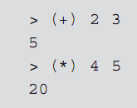

Elements of Haskell (cont’d.)
Infix functions can be turned into prefix functions by surrounding them with parentheses
Haskell has anonymous functions or lambda forms, with the backslash representing the lambda

Slide 95
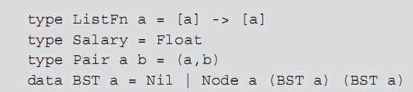
Higher-Order Functions and List Comprehensions
Haskell includes many predefined higher-order functions, such as map, that are all in curried form
It has built-in lists and tuples, type synonyms, and user-defined polymorphic types

Slide 96
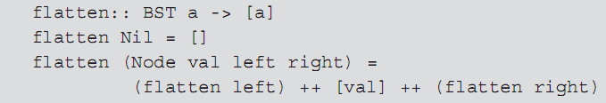
Higher-Order Functions and List Comprehensions (cont’d.)
Type variables are written without the quote of ML and are written after the data type name, not before
data keyword replaces ML’s datatype keyword
Type and constructor names must be uppercase, while function and value names must be lowercase
Functions on new data type can use data constructors as patterns, as in ML

Slide 97
Higher-Order Functions and List Comprehensions (cont’d.)
List comprehension: a special notation for operations applied to lists
Example: squaring a list of integers
This is syntactic sugar for:

Slide 98
Lazy Evaluation and Infinite Lists
Haskell is a lazy language – no value is computed unless it is actually needed
Lists in Haskell are the same as streams and can be potentially infinite
Haskell has several shorthand notations for infinite lists, such as [n..], which means a list of integers beginning with n
take function: extracts the first n items from a list
drop function: discards the first n items from a list

Slide 99
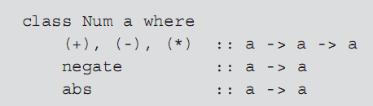
Type Classes and Overloaded Functions
Haskell allows overloading of functions
Type class:
A set of types that all define certain functions
Specifies the names and types (called signatures) of the functions that every type belonging to it must define
Similar to Java interfaces

Slide 100
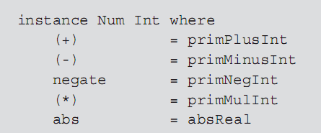
Type Classes and Overloaded Functions (cont’d.)
Instance definition: contains the actual working definitions for each of the required functions
Many type classes themselves are defined to be part of other type classes
This dependency is called type class inheritance

Slide 101
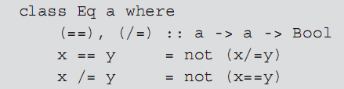
Type Classes and Overloaded Functions (cont’d.)
Type inheritance relies upon a hierarchy of type classes
Eq and Show classes are the base classes
All predefined Haskell types are instances of the Show class
Eq class establishes the ability of two values of a member type to be compared using == operator

Slide 102
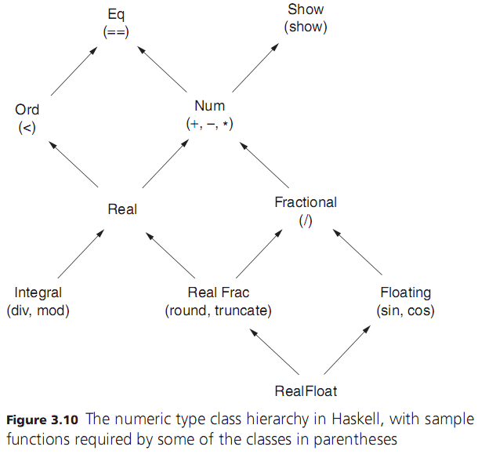

Slide 103
The Mathematics of Functional Programming: Lambda Calculus
Lambda calculus: invented by Alonzo Church in the 1930s
A mathematical formalism for expressing computation by functions
Can be used as a model for purely functional programming languages
Many functional languages, including Lisp, ML and Haskell, were based on lambda calculus

Slide 104

Lambda Calculus (cont’d.)
Lambda abstraction: the essential construct of lambda calculus:
Can be interpreted exactly as this Scheme lambda expression:
An unnamed function of parameter x that adds 1 to x
Basic operation of lambda calculus is the application of expressions such as the lambda abstraction

Slide 105

Lambda Calculus (cont’d.)
This expression:
Represents the application of the function that adds 1 to x to the constant 2
A reduction rule permits 2 to be substituted for x in the lambda, yielding this:

Slide 106


Lambda Calculus (cont’d.)
Syntax for lambda calculus:
Third rule represents function application
Fourth rule gives lambda abstractions
Lambda calculus as defined here is fully curried

Slide 107
Lambda Calculus (cont’d.)
Lambda calculus variables do not occupy memory
The set of constants and the set of variables are not specified by the grammar
It is more correct to speak of many lambda calculi
In the expression
x is bound by the lambda
The expression E is the scope of the binding
Free occurrence: any variable occurrence outside the scope
Bound occurrence: an occurrence that is not free

Slide 108
Lambda Calculus (cont’d.)
Different occurrences of a variable can be bound by different lambdas
Some occurrences of a variable may be bound, while others are free
Can view lambda calculus as modeling functional programming:
A lambda abstraction as a function definition
Juxtaposition of two expressions as function application

Slide 109
Lambda Calculus (cont’d.)
Typed lambda calculus: more restrictive form that includes the notion of data type, thus reducing the set of expressions that are allowed
Precise rules must be given for transforming expressions
Substitution (or function application): called beta-reduction in lambda calculus
Beta-abstraction: reversing the process of substitution
Beta-conversion: either beta-reduction or beta-abstraction

Slide 110
Lambda Calculus (cont’d.)
Name capture problem: when doing beta-conversion and replacing variables that occur in nested scopes, an incorrect reduction may occur
Must change the name of the variable in the inner lambda abstraction (alpha-conversion)
Eta-conversion: allows for the elimination of “redundant” lambda abstractions
Helpful in simplifying curried definitions in functional languages

Slide 111
Lambda Calculus (cont’d.)
Applicative order evaluation (pass by value) vs. normal order evaluation (pass by name)
Example: evaluate this expression:
Use applicative order; replacing (1 2 3) by its value and then applying beta-reduction gives:
Use normal order; applying beta-reduction first and then evaluating gives:
Normal order evaluation is a kind of delayed evaluation

Slide 112
Lambda Calculus (cont’d.)
Different results can occur, such as when parameter evaluation gives an undefined result
Normal order will still compute the correct value
Applicative order will give an undefined result
Functions that can return a value even when parameters are undefined are said to be nonstrict
Functions that are undefined when parameters are undefined are said to be strict
Church-Rosser theorem: reduction sequences are essentially independent of the order in which they are performed

Slide 113
Lambda Calculus (cont’d.)
Fixed point: a function that when passed to another function as an argument returns a function
To define a recursive function in lambda calculus, we need a function Y for constructing a fixed point of the lambda expression for the function
Y is called a fixed-point combinator
Because by its nature, Y will actually construct a solution that is in some sense the “smallest”; one can refer to the least-fixed-point semantics of recursive functions in lambda calculus

